Slide 1
Python Based Customized SerDes Generator in for Chipathon
https://github.com/muhammadusman7/serdes_chipathon_2023

Slide 2
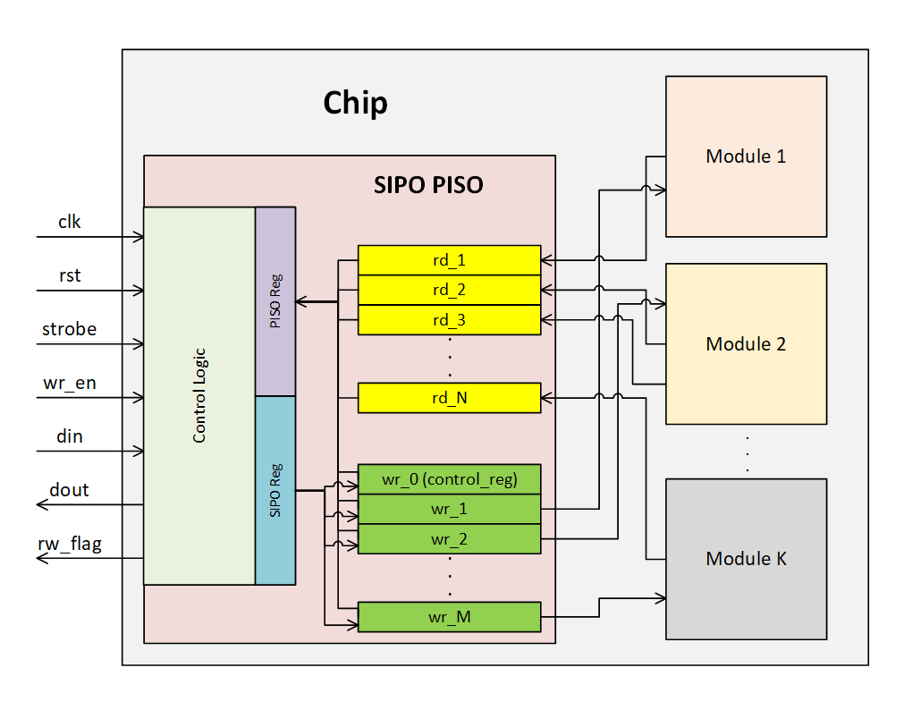
Block Diagram

Slide 3
Main Features
Python based Verilog code generation in seconds
Total Pins: 7, Read/Write in chip as many as you want
Customize:
Register Width
Read Depth
Write Depth
Reset to default (default.mem)
Read at negedge and writes at posedge of the clk
Code Generation is discussed in detail at README.md
Testbench with random read/write data values.
Makefile for Iverilog/Incisive/Xcelium Simulation

Slide 4
Serial In Parallel Out (SIPO)
Starts with Strobe for 1 Cycle keeping wr_en high
After strobe start sending data bits
Followed by address bits
rw_flag becomes high after completing a SIPO operation for a single cylce and device goes to IDLE state
New transaction can be started by sending strobe again

Slide 5
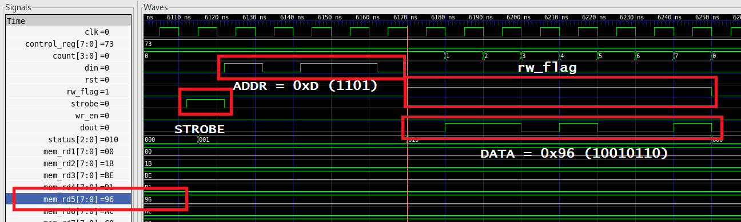
Parallel In Serial Out (PISO)
Starts with Strobe for 1 Cycle keeping wr_en low
After strobe start sending address bits
Once Adress bits are sent rw_flag becomes
rw_flag becomes high after completing a SIPO operation for a single cylce and device goes to IDLE state
New transaction can be started by sending strobe again

